Slide 1
Faculty applicant data compilation process

Slide 2
AGenda
Welcome and Introductions
FAQ’s
Why we are changing
Demonstration
Q&A

Slide 3
Why are we doing this
Federal Contractor
Governmental Compliance
Affirmative Action Plan as a tool
Assess the progress of our good faith efforts

Slide 4
Why is this important?
Standardize the applicant tracking process for faculty
Ensure that every School is using the same criteria to define an applicant
Properly disposition faculty applicants
Reporting to the OFCCP because of the Compliance Review

Slide 5
A case for The new process
We believe that more applicants will be willing to send information electronically rather than on paper.
We will be able to provide de identified demographic information to the departments
We can suggest sources for women and Underrepresented Minorities
Be in compliance with the OFCCP

Slide 6
Who is an Applicant
The Office of Federal Contracts Compliance Program (OFCCP) is responsible for ensuring regulatory compliance of organizations who have federal contracts. The University of Pittsburgh is one of those organizations.
In order to ensure consistency in the evaluation process; the OFCCP has developed criteria for candidates who apply for positions with the contractors to be considered applicants.
OFCCP developed an Applicant Rule which in effect covers all job seekers. [ referred to as the Internet Applicant Rule]

Slide 7
What is the definition of an “Applicant”?
An “Applicant” is an individual who satisfies all four of the following criteria:
The individual submitted an expression of interest in employment through the Internet or related electronic data technologies;
The contractor considered the individual for employment in a particular position;
The individual’s expression of interest indicated that the individual possesses the basic qualifications for the position; and
The individual, at no point in the contractor’s selection process prior to receiving an offer of employment from the contractor, removed himself or herself from further consideration or otherwise indicated that he/she was no longer interested in the position.

Slide 8
Applicant
When a job seeker meets these 4 criterion, they are an applicant. All Applicants must be given the opportunity to voluntarily disclose their demographic information, e.g. race, gender, ethnicity, Veteran and/or disability status.

Slide 9
Register your search
Once your Pre-audit form has been approved. You will receive the following email from the Office of Diversity and Inclusion inviting you to register your search.
“The Office of Diversity and Inclusion has approved the Pre-audit form that you submitted for your open faculty position. The attached training walks you through the process of registering your position, adding and dispositioning the applicants and sending out the EEO forms. “

Slide 10
Registering the requisition on Qualtrics
Administrator Name
Administrator email
Department Name
Department Number
Position Number*
*For Part-time, visiting or dual career opportunities use requisition number in lieu of position number
Rank / Title
Date Position was posted

Slide 11
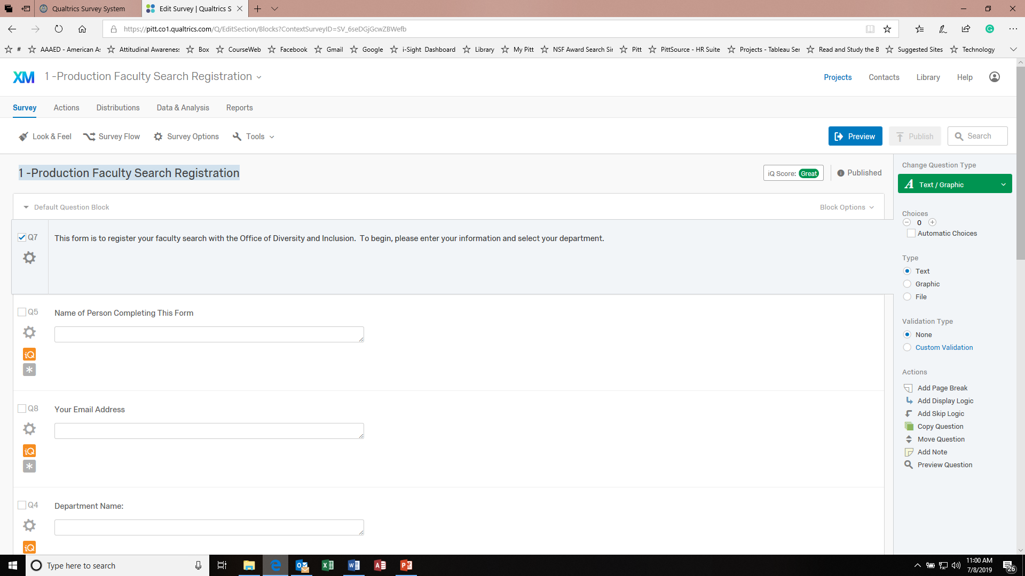

Slide 12
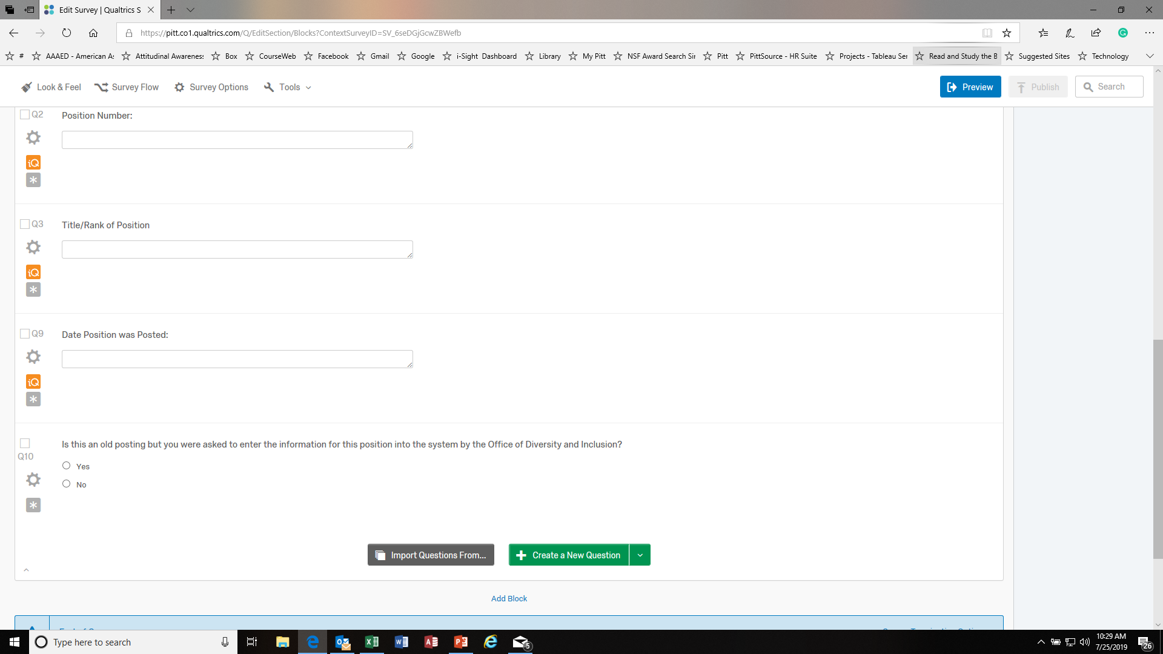

Slide 13
Administrator will receive the following
Hello Administrator, Thank you for registering your faculty search with the Office of Diversity and Inclusion. The details of this position are here: Department Name: Department Number: Position Number: 9999999 Title/Rank of Position: tenure Date Position was Posted: 06-05-2019 To begin sending out the EEO form to the applicants of this position please click the link below. You will need to click this link to register each and every applicant that has applied for this position. Please use the link below to appropriately disposition the applicants for this position.
Applicants do not need to be fully dispositioned all at once. Maintain this link to come back and disposition in the future.
Register an applicant for this position

Slide 14
Searches' that were previously completed
Is this a completed search and you sent out EEO forms to the applicants during the search and were asked to enter disposition information by the Office of Diversity and Inclusion?
Yes – the administrator will be able to register the search without EEO forms going out to the applicants
No- the Administrator can register the search and the EEO forms will go to the applicants (this means that you are registering a current search)

Slide 15
Registering Applicants
When you click on register an applicant for this position, the applicant will receive the link to the EEO form.

Slide 16
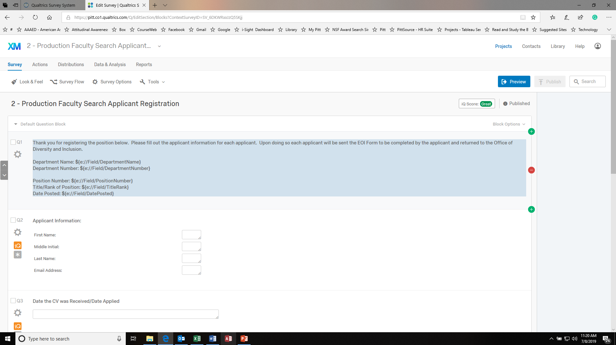

Slide 17
Applicant receives the following email
Thank you for your interest in this opportunity at the University of Pittsburgh. Founded in 1787 as the Pittsburgh Academy, the University has become a world-renowned state-related research institution and continues to offer countless opportunities across the disciplines for its students, staff, and faculty to excel, as evident in its Association of American Universities (AAU) membership. In accordance with federal guidelines, an applicant is to be given the opportunity to voluntarily disclose demographic information. If you choose to disclose, none of your information is used against you. All information is collected by the Office of Diversity and Inclusion for reporting purposes. Provide your information If you have any questions about the information request, please feel free to contact the Office of Diversity and Inclusion at diversity@pitt.edu. For additional information about the University of Pittsburgh's diversity efforts, visit www.diversity.pitt.edu. Thank you and Hail to Pitt!

Slide 18
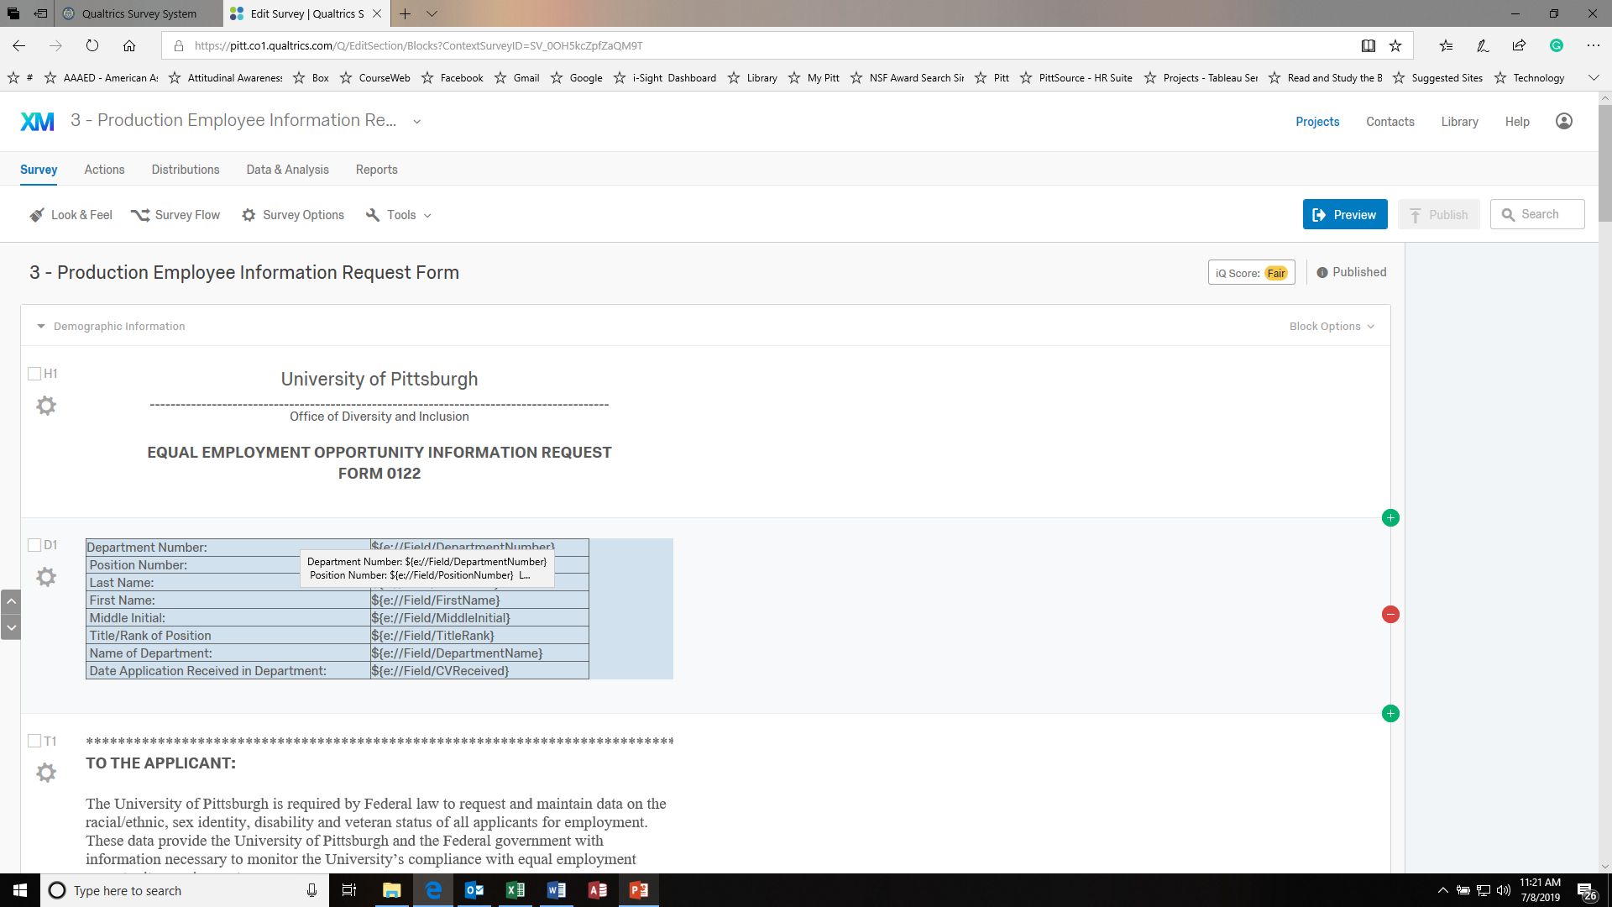

Slide 19
Part time and visiting Searches that were not posted in talent center
Prior to July 2019 part time and visiting opportunities were not posted on Talent Center.
The applicants were not given the opportunity to disclose their demographic information.
The University is obligated to give applicants the opportunity to disclose their demographic information.

Slide 20
Registering Part-time requisitions on Qualtrics
Administrator Name
Administrator email
Department Name
Department Number
Position Number*
*use the hired candidates employee number
Rank / Title
Date Position was posted

Slide 21
Launch EEO Forms to applicants
Please use the following survey to send out the EEO form to those applicants.
https://pitt.co1.qualtrics.com/jfe/form/SV_9FEQ1uEG0cbLH25

Slide 22
Applicant will receive the following email
As a Federal Contractor, the University of Pittsburgh must provide the opportunity for applicants to voluntarily disclose their demographic information when they apply for a position. The Office of Diversity and Inclusion has been made aware that you were not given the opportunity to disclose your information when you submitted your CV for the position referenced below. For reporting purposes, we ask that you consider completing the attached EEO form. The decision to provide this information is voluntary. We realize this position may no longer be open and this request does not indicate any change in the hiring process. If you have questions about this email, please send your questions to diversity@pitt.edu. Respectfully, The Office of Diversity and Inclusion

Slide 23
Now you have an applicant pool What next? Registering applicants
Using the disposition codes allows you to refine the search using relevant criterion so to make the best hiring decision.
Using disposition codes helps to ensure that you are removing job seekers from the pool for relevant non-discriminatory reasons
Notes:
While you are reviewing the resumes and CV’s of the job seekers, it is important to code them appropriately so to indicate if they should be included as the search continues or removed for objective non-discriminatory reasons.

Slide 24
New – to be reviewed
Applicant Applied too late in the process
Candidate communicates No longer interested
Does not meet minimum qualifications – Education
Does not meet minimum qualifications – Experience
Does not meet minimum qualifications – Both Education and Experience
Qualified

Slide 25
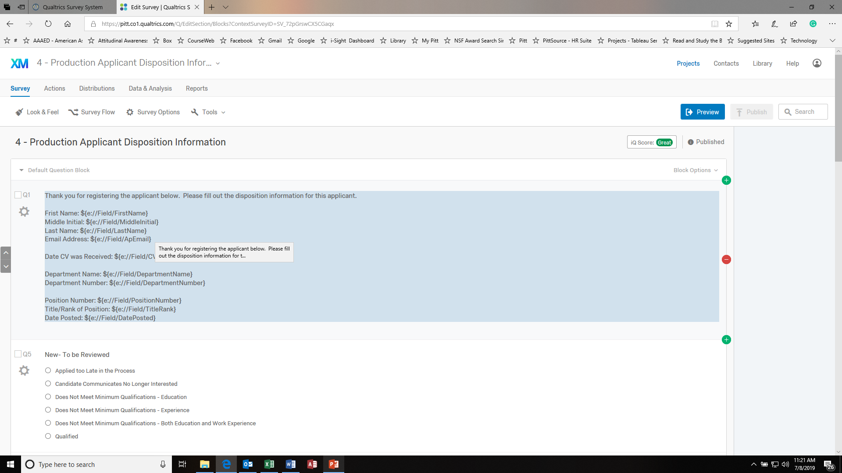

Slide 26
Committee Review
Applicant Communicates No Longer Interested
Qualified, Not Selected - Does not meet Preferred Qualifications and/or Qualifications Not as Strong as Other Applicants - Education
Qualified, Not Selected - Does not meet Preferred Qualifications and/or Qualifications Not as Strong as Other Applicants - Experience/Key Accomplishments
Qualified, Not Selected - Does not meet Preferred Qualifications and/or Qualifications Not as Strong as Other Applicants - Education and Experience/Key Accomplishments
Selected for Interview

Slide 27
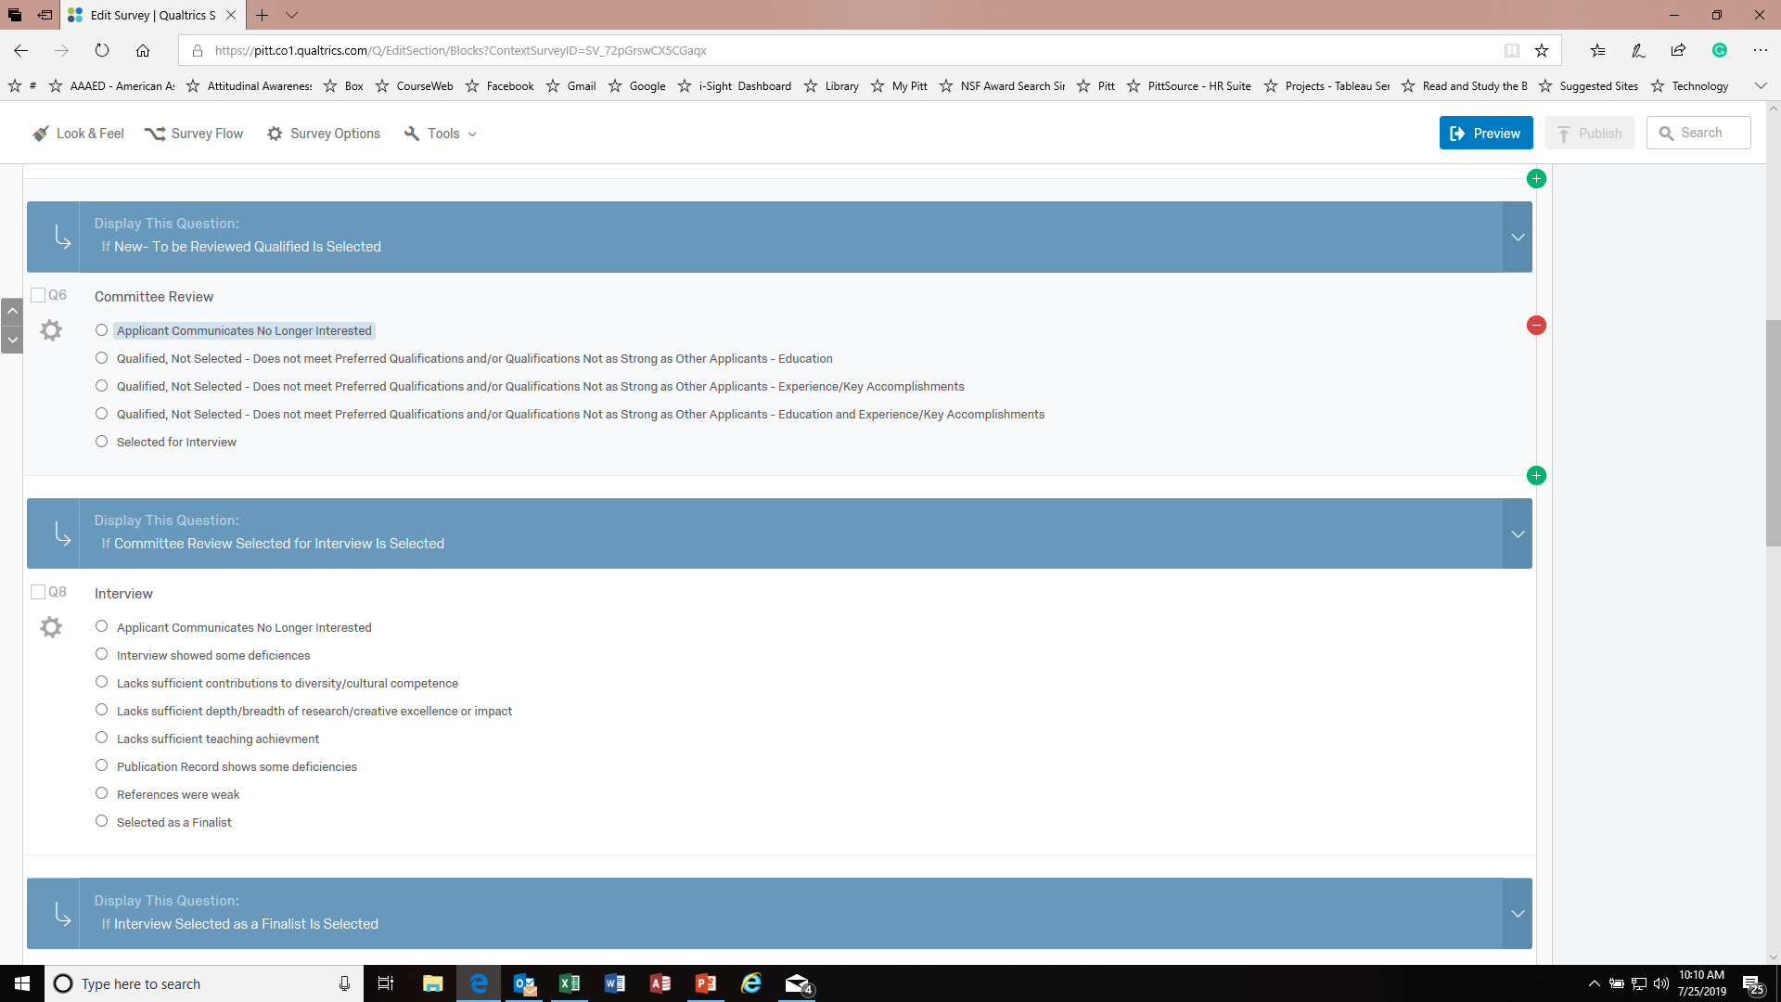

Slide 28
interview
Applicant Communicates No Longer Interested
Interview showed some deficiencies
Lacks sufficient contributions to diversity/cultural competence
Lacks sufficient depth/breadth of research/creative excellence or impact
Lacks sufficient teaching achievement
Publication Record shows some deficiencies
References were weak
Selected as a Finalist

Slide 29
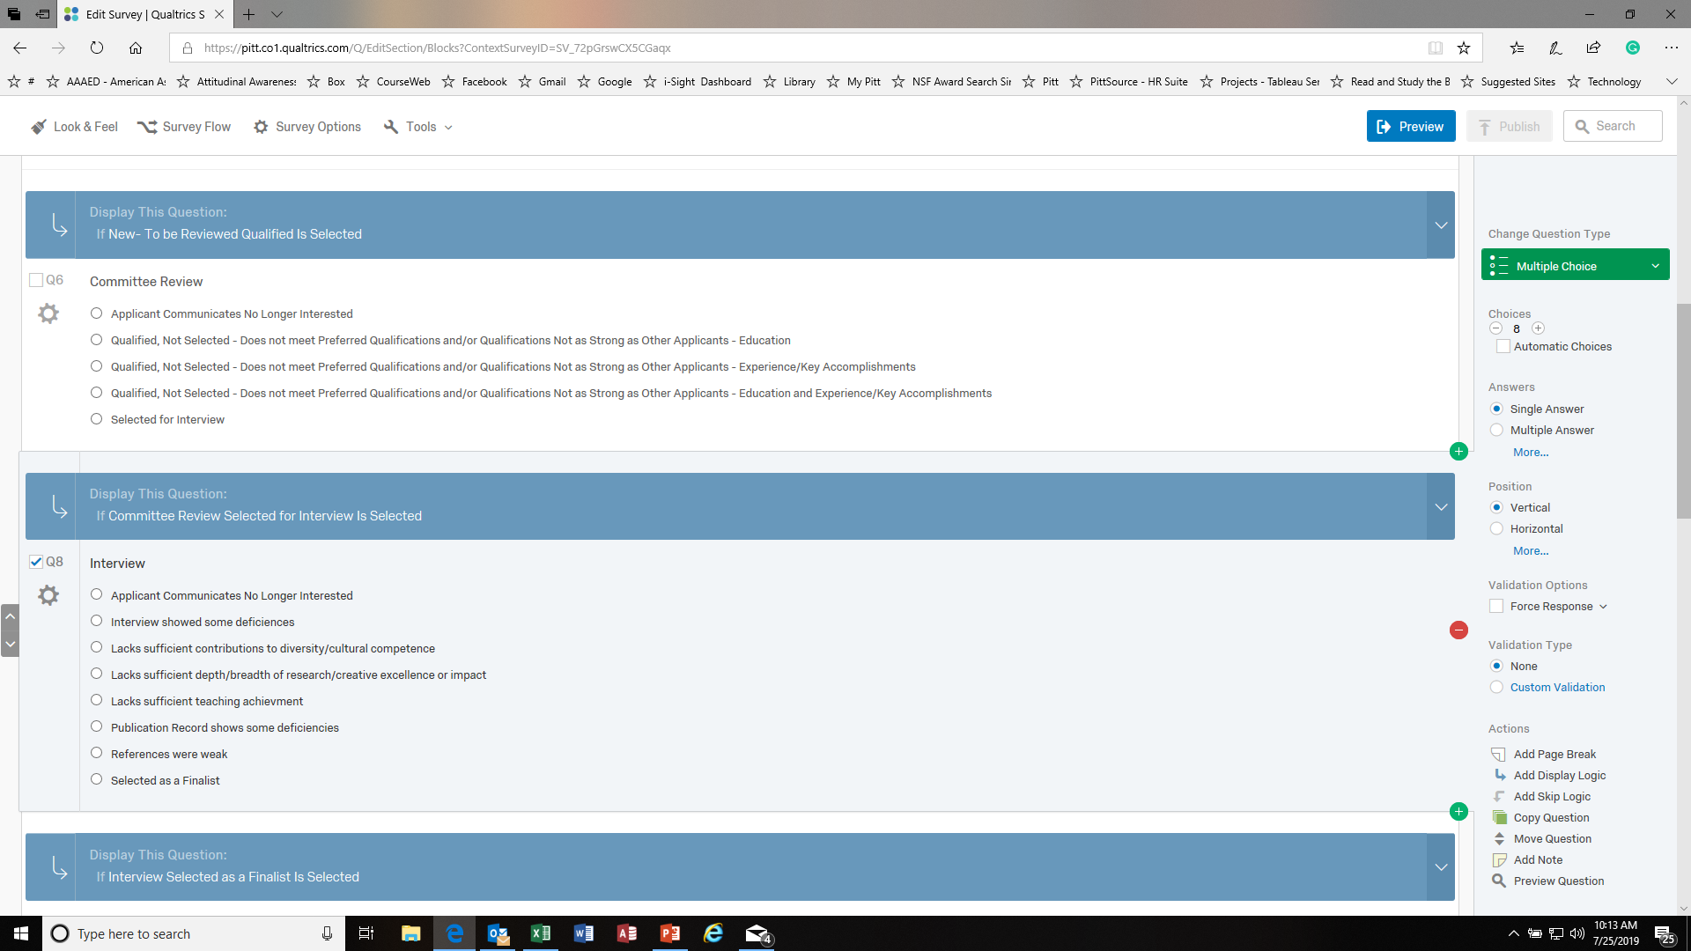

Slide 30
finalist
Applicant Communicates No Longer Interested
Alternate for the position (ranking)
The in-person talk showed some deficiencies
Recommendations and dossier not as strong as other applicants
Not as strong relative to other finalists
Selected

Slide 31
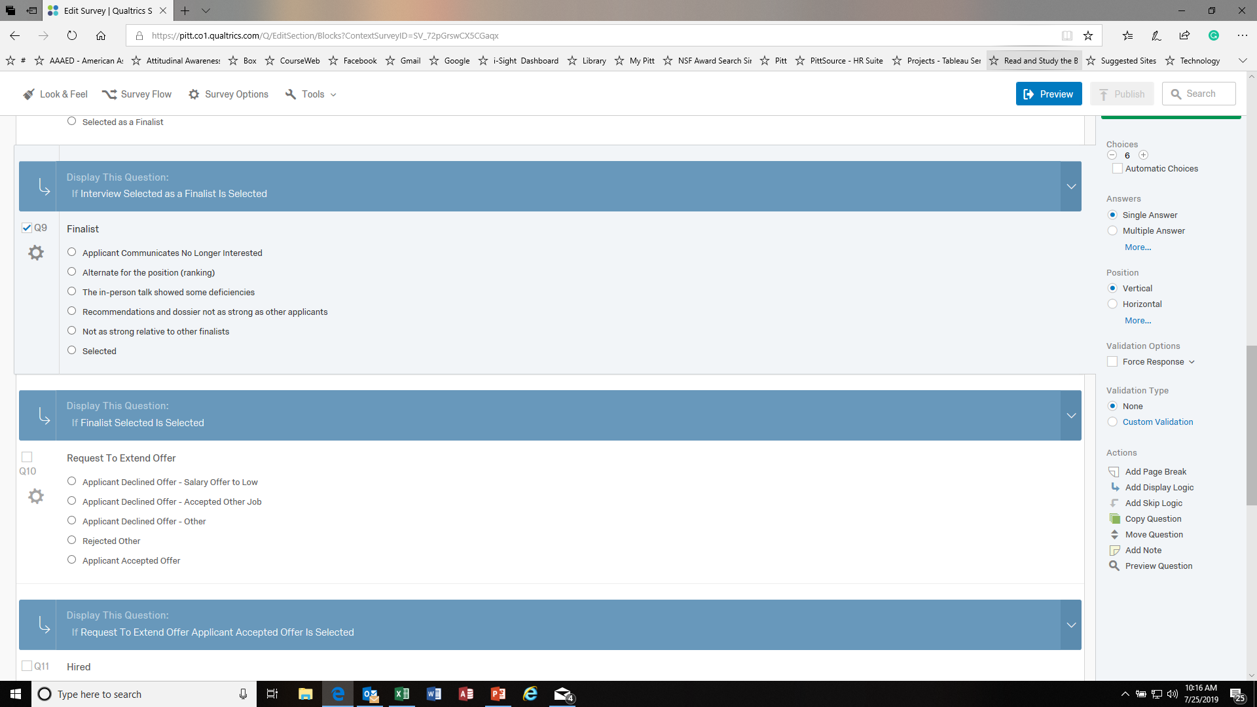

Slide 32
Request to extend offer
Applicant Declined Offer - Salary Offer to Low
Applicant Declined Offer - Accepted Other Job
Applicant Declined Offer - Other
Rejected Other
Applicant Accepted Offer
Notes:
There are many options for being rejected. Administrator should review them and choose the most appropriate code.

Slide 33
hired
You have refined the search to find the best candidate for the position

Slide 34
What Next
Retain your interview notes for 3 years
Let ODI know that the position has been filled

Slide 35
Questions
Cheryl Ruffin – 412 648-7292
Warren McCoy – 412 648-7863
Tiara Nicholson – 412 648-5445

